Slide 1


Slide 2
Kaltura Academic Media and Pedagogy (KAMP)
Focus on Pedagogy
Byte-Sized Learning
This series is intended to help our users who are faculty and instructional designers, with best practices for using video in their teaching.
30-minute sessions with time for Q&A. No more than 45 minutes.
https://corp.kaltura.com/kamp-webinars/
Coming at You Monthly!
Help Us Get the Word Out!
Second Thursday of each month at 2:00 PM EDT.
Please forward webinar invites to your faculty and designers! This is all about them!
We Want to Highlight Your Institution!
Upcoming Topics:
Best practices for teaching with video!
See you in the Fall!!!
We would love to put your designers or faculty on stage! What cool things are you doing with Kaltura? Consider presenting! Call for proposals on KAMP website.

Slide 3
Improving Content Navigation and Access in Your Online Course With Kaltura’s Media Gallery
May 2022
Ben Emery ~ Sr. Solutions Engineer, NA EDU

Slide 4
Agenda
Online course design rubrics
Content navigation and organization
Kaltura Media Gallery
Tips to get started

Slide 5
Rubrics for Online Course Design

Slide 6



Quality Matters
QM Course Design Rubric Standards
Online Learning Consortium
OLC OSCQR Course Design Review Scorecard
Blackboard
Blackboard Exemplary Course Program Rubric

Slide 7
Poll Time!
Are you currently using a rubric standard in your course design process?
A. QM
B. OLC
C. Blackboard
D. None of these

Slide 8
The criteria/standards/guidelines
Are independent of the learning platform and technologies
Support continuous improvement initiatives, strategic planning, and help identify strengths and weaknesses in your online courses
Provide suggestions for organization, management, and implementation of online courses
Provide expectations for the good design and teaching of online courses

Slide 9
QM Course Design Rubric Standards 6th Ed (Higher Ed)
1
2
3
4
Course Overview and Introduction
(9 standards)
Learning Objectives (Competencies) (5 standards)
Assessment and Measurement
(5 standards)
Instructional Materials
(5 standards)
5
6
7
8
Learning Activities and Learner Interaction
(4 standards)
Course Technology
(4 standards)
Learner Support
(4 standards)
Accessibility and Usability
(6 standards)

Slide 10
OLC OSCQR Course Design Review Scorecard
1
Course Overview and Information (10 Standards)
2
Course Technology and Tools (5 standards)
3
Design and Layout (13 standards)
4
Content and Activities (9 standards)
5
Interaction (6 standards)
6
Assessment and Feedback (7 standards)

Slide 11
Blackboard Exemplary Course Program Rubric
1
Course Design (16 standards)
2
Interaction & Collaboration (9 standards)
3
Assessment (8 standards)
4
Learner Support (19 standards)

Slide 12
Content navigation and easy access
QM Course Design Rubric
Standards 8.1 through 8.6 under “Accessibility and Usability
OLC OSCQR Scorecard
Thirteen guidelines under the “Design and Layout”
Blackboard Rubric
Subcategory “content composition and structure” under the category “Course Design” includes 4 standards

Slide 13
Kaltura
Supports good organization and access of video media

Slide 14
Poll Time!
On a scale of 1-5 how familiar are you with Kaltura’s Media Gallery?

Slide 15
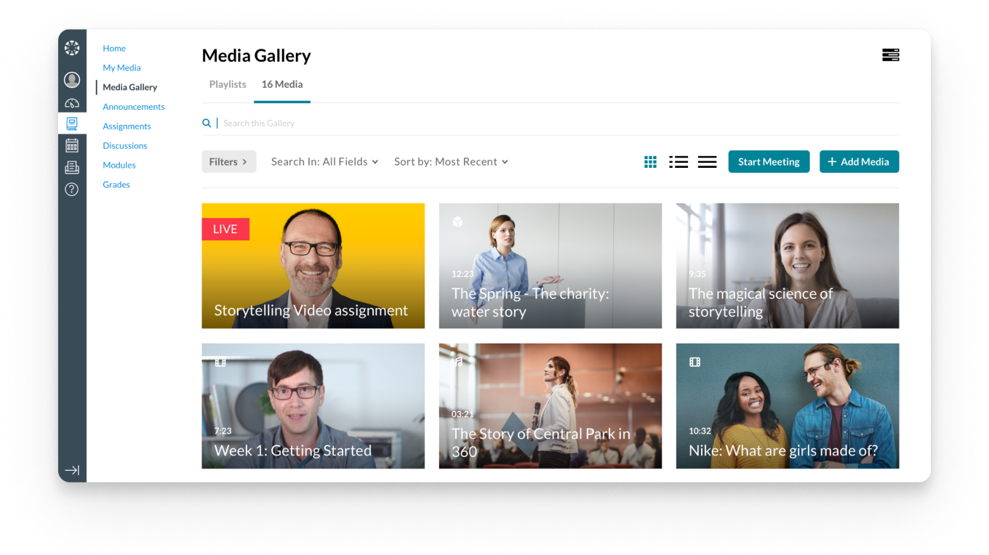
The Kaltura Media Gallery

Slide 16
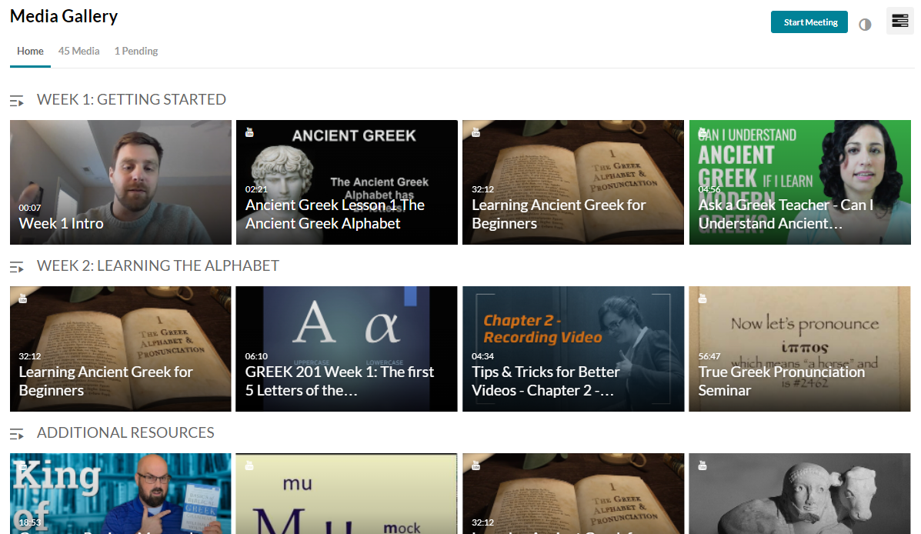
Playlists
Create and organize playlists in the Media Gallery.

Slide 17
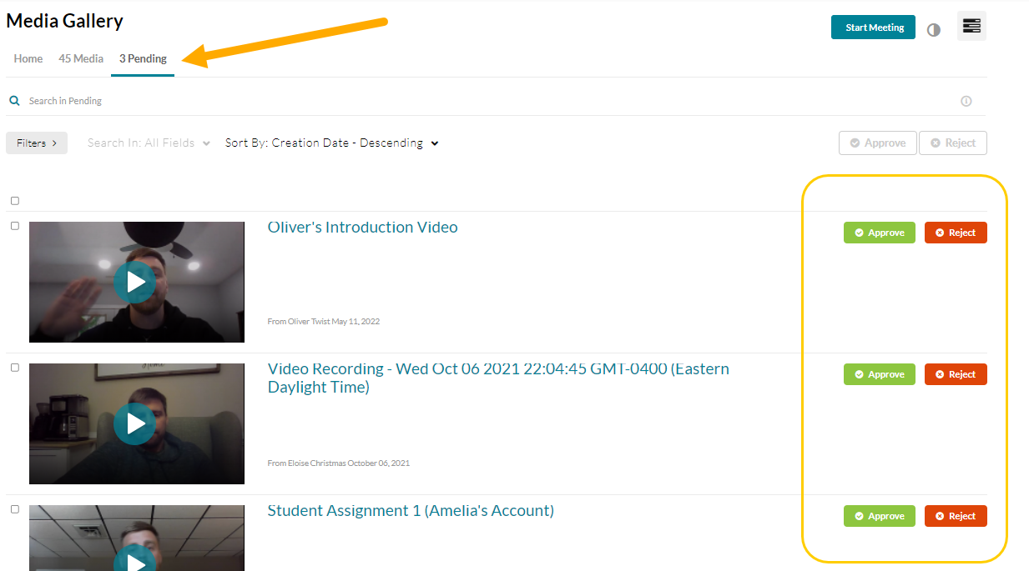
Student Engagement
Students can add videos to the Media Gallery for peer review and collaboration.

Slide 18
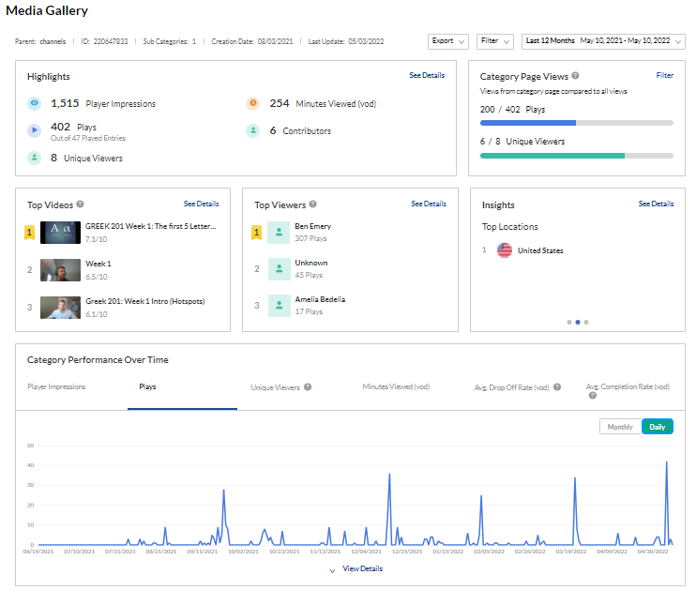
Analytics
Valuable insights to see how your content is being watched.

Slide 19
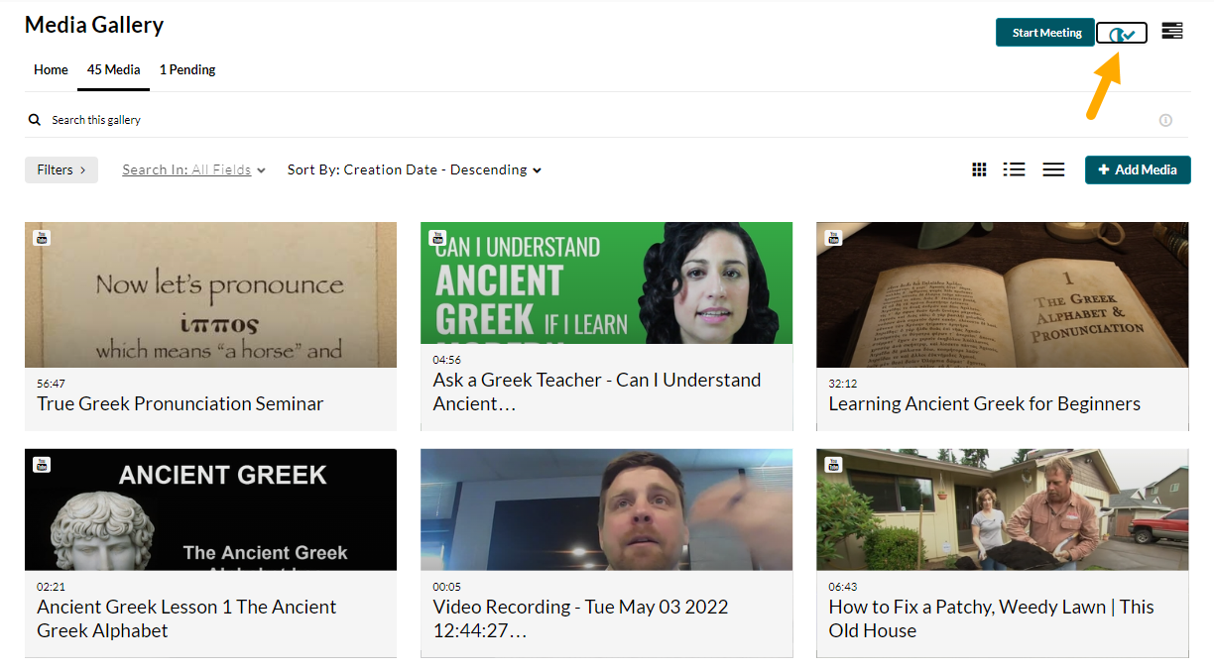
Accessibility

Slide 20
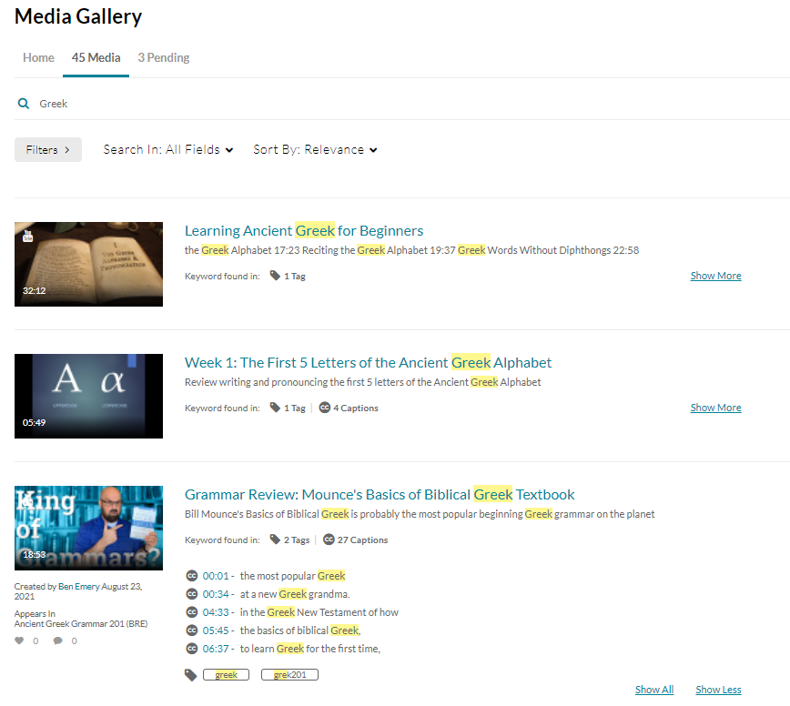
Search
Students can use Elastic Search to easily find content and go directly to a point in the video.
Filters allow easy sorting

Slide 21
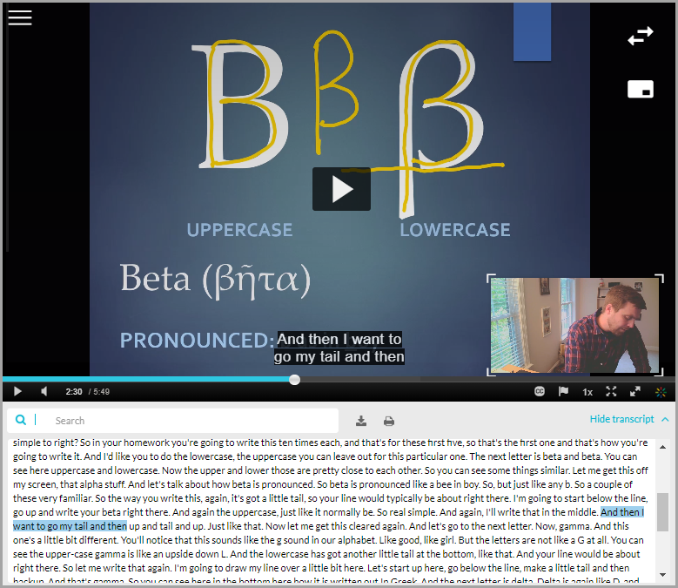
Transcript
Player transcript allows the viewer to easily follow along.
Transcript is fully searchable and can be downloaded or printed.

Slide 22
Some advice to get you started
Work with peers
Use standards contained in one or more of the already created rubrics
Develop a continuous improvement plan
Start small
Work progressively towards quality.

Slide 23
To enhance access of content in your online course
Start implementing basic accessibility features in your media content.
Make sure media files can be accessed with the several browsers.

Slide 24
To enhance organization of content in your online course
Aim for consistency
Organize the content in manageable logical chunks
Place content in different logical places (redundancy)
In Kaltura videos, add consistent keywords that are easily related to the content (e.g., topic), meaningful titles and descriptions.
Make the Kaltura media gallery accessible to your students and for easy access to videos in the media gallery, organize the videos in playlists.

Slide 25
Thank you!
Ben Emery
Ben.emery@kaltura.com

Slide 26

Resources
Ko, S., & Rossen, S. (2017). Teaching online: A practical guide. Routledge.
Quality Matters Course Design Rubric Standards.
  https://www.qualitymatters.org/qa-resources/rubric-standards/higher-ed-rubric
  https://www.qualitymatters.org/sites/default/files/PDFs/StandardsfromtheQMHigherEducationRubric.pdf
The OLC OSCQR Course Design Review Scorecard https://onlinelearningconsortium.org/consult/oscqr-course-design-review/
Blackboard Exemplary Course Program Rubric
https://www.blackboard.com/resources/are-your-courses-exemplary

