Slide 1


Slide 2






Kaltura Academic Media and Pedagogy (KAMP)
Focus on Pedagogy
Byte-Sized Learning​
This series is intended to help our users who are faculty and instructional designers, with best practices for using video in their teaching.
30-minute sessions with time for Q&A. No more than 45 minutes.
Coming at You Monthly!
Help Us Get the Word Out!
Second Thursday of each month at 2:00 PM EDT.
https://corp.kaltura.com/kamp-webinars/
Please forward webinar invites to your faculty and designers! This is all about them!
We Want to Highlight Your Institution!
Upcoming Topics:
Best practices for teaching with video!
• Back in February - Different Types of Interaction that Promote Learning in the Online Synchronous Classroom - Kaltura
We would love to put your designers or faculty on stage! What cool things are you doing with Kaltura? Consider presenting! Call for proposals on KAMP website.

Slide 3
Strategies for Student Success Using Kaltura Tools
Rowan University
December 2021
Michael Ciocco, Assistant Vice President of Rowan Online
Jennifer Sedlock, Online Learning Experience Coordinator

Slide 4
About Us…
Jennifer Sedlock Online Learning Experience Coordinator Doctoral Candidate sedlockj@rowan.edu Michael Ciocco Assistant Vice President for Rowan Online ciocco@rowan.edu
Rowan University, Glassboro, NJ
Public | R2 Research | 20k+ FTE
Rowan Online
Established 2006 | Nearly 50 Programs | Over 10k Students Annually

Slide 5
Using Kaltura Tools at Rowan University
Cultivates student-centered learning environments to foster a sense of inclusion and community
Kaltura Tools
Kaltura Media Gallery
Kaltura MediaSpace
Kaltura Capture
Analytics
Editing Tools
In-Video Quizzes
Kaltura Interactive Video Paths
Three Strategies: Bring the student into focus while improving learning outcomes

Slide 6
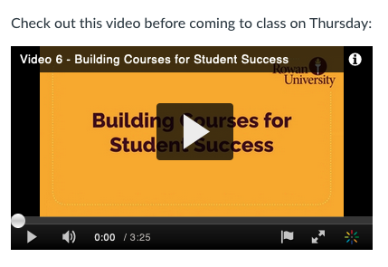

Strategy 1 - Sharing and Feedback
Course Announcements
Video Discussion Prompts

Slide 7

Strategy 1 - Sharing and Feedback
Grading
Project Feedback
Notes:
Jennifer, please add your video on this slide. PPT won’t play nicely with Google ;-(
https://drive.google.com/file/d/1kUMdCeyLXzzXRHbBvD0-3BbQSGKdqiLk/view?resourcekey

Slide 8
Strategy 2 - Formative Reflection and Checking for Understanding

Slide 9
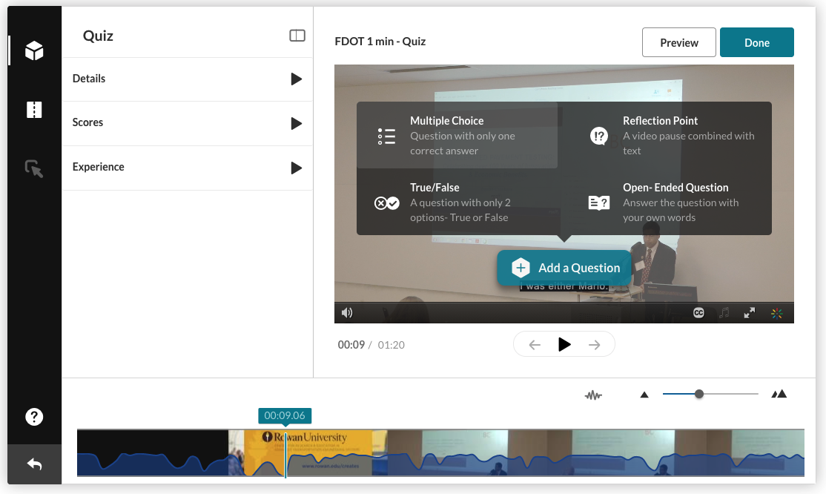
Inserting a Reflection Point

Slide 10
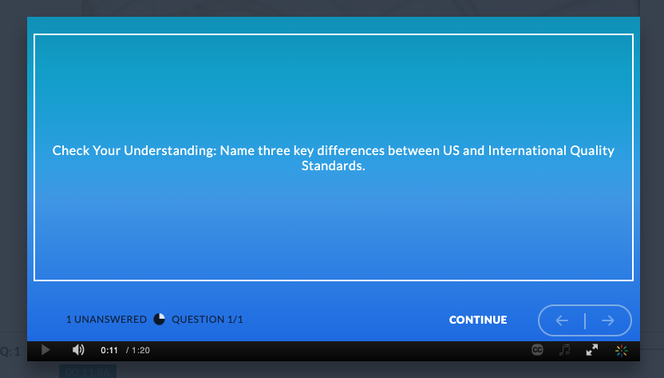
Example Prompts

Slide 11
More Example Prompts
Prompt: Case Study: Customer Quality Feedback at Apple Computer. We will examine this case in depth during class discussion. [prompt appears before case study segment].
Related Discussion: What changes would you make in Apple’s Customer Feedback System?
Prompt: Objective: Understand customer driven quality through the voice of the customer.
TIP! Work in reverse order, deriving your prompts from your planned objectives, discussions, assignments, and assessments.

Slide 12
Strategy 3 - Student as Content Creator
Purpose?
Demonstrate comprehension of content, subject matter, etc.
Showcase ability to create content
Knowledge acquisition skills
Practice presentation skills
How?
Students create and upload videos to the course Media Gallery
Opportunities for Interaction
Consider allowing students to comment on videos
Peer Review through LMS

Slide 13
Strategy 3 - Examples
Student Becomes the Teacher
Flip the Assignment - students create content!
Instructor provides a theme, structure, and parameters
Peer to peer instruction and learning
Problem-Based Learning
Problems can be established via video
Students can respond to problem via video
Student groups with virtual briefings and meetings to be recorded and posted
Groups foster collaboration

Slide 14
What can I do now?
Right now!
Strategy 1: Sharing and Feedback
Short term (some time/planning investment needed)
Strategy 2: Formative Reflection and Checking for Understanding
Future (may need more planning and preparation)
Strategy 3: Student as Content Creator

Slide 15
Thank you! Questions and Resources sedlockj@rowan.edu ciocco@rowan.edu

